Slide 1
Factors Associated with Obesity
Exploratory Data Analysis Assignment
Alima, Nia, Faryal and Ellen

Slide 2
Introduction to Obesity
Obesity is a global health concern
Associated with cardiovascular disease, liver disease, chronic pain…
In Mexico, recently estimated to impact 80% of adults (Barquera & Rivera, 2020)
Large increase since 1999 (estimated at 24%)
Economic impact as obesity can impair economic growth and strain healthcare services
Understanding factors associated with obesity may help to improve health of the population, and reduce economic burden.

Slide 3
Dataset Introduction
The dataset used focuses on estimating obesity levels based on individuals' eating habits, physical activity, and personal background.
Includes 2,111 records with 17 features, covering both numeric factors such as age, height, and weight, and categorical factors like gender, family history of overweight, and transportation methods.
Participants from Colombia, Peru and Mexico aged 14-61 (anonymous from online survey)
The goal of the analysis is to explore how these different variables are associated with obesity risk.
From UC Irvine Machine Learning Repository
Research by Palechor and Manotas (2019)

Slide 4
Feature Description and Data Types
Total Rows: 2,111
Total Columns: 17
Numeric Features: 8
Number of Meals per Day (Range between 1 - 3)
Age, Height, Weight (1035 Females, 1052 Males)
Amount of water per day (Range between 1 - 3)
Vegetable Consumption Frequency (Range between 1 - 3)
Time spent on technology (Range between 0 - 2)
Exercise per week (Range between 1 - 3)
Binary Features: 5
Family History with Overweight
Smoking
Calorie Monitoring
High calorie diet
Gender
Categorical Features: 4
Alcohol Consumption (No, Sometimes, Frequently, Always)
Snacking Frequency (No, Sometimes, Frequently, Always)
Transportation (Public Transport, Walking, Car, Motorbike, Bicycle)
Obesity Level (Underweight, Normal Weight, Overweight I, Overweight II, Obese I, Obese II, Obese III)
Notes:
For reference, don’t need to go into detail, but this is a summary

Slide 5
Preprocessing/Cleaning Data Pipeline
Importing Data
Renaming Columns
Checking Missing Values
Removing Duplicates
Verifying Data-types + Recoding
Easier understanding and analysis
Making sure they are appropriate for later analysis

Slide 6
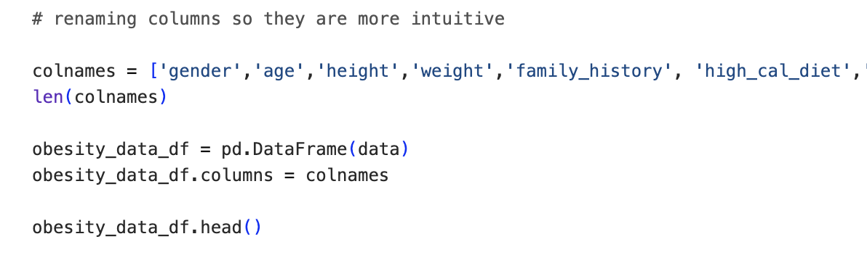
Renaming Columns:
FAVC → high_cal_diet (binary)
FCVC → veggie_diet (binary)
NCP → amt_daily_meals (numeric)
CAEC → snacking (numeric)
SMOKE → smoking (binary)
CH20 → amt_water (numeric)
SCC → cal_monitoring (binary)
FAF → exercise_per_week (numeric)
TUE → time_spent_technology (numeric)
CALC → freq_alcohol (numeric)
MTRANS → transportation (categorical)
NObeyesdad → obesity severity group (categorical)
GENDER → gender (binary)
AGE → age (numeric)
WEIGHT → weight (numeric)
HEIGHT → height (numeric)

Slide 7
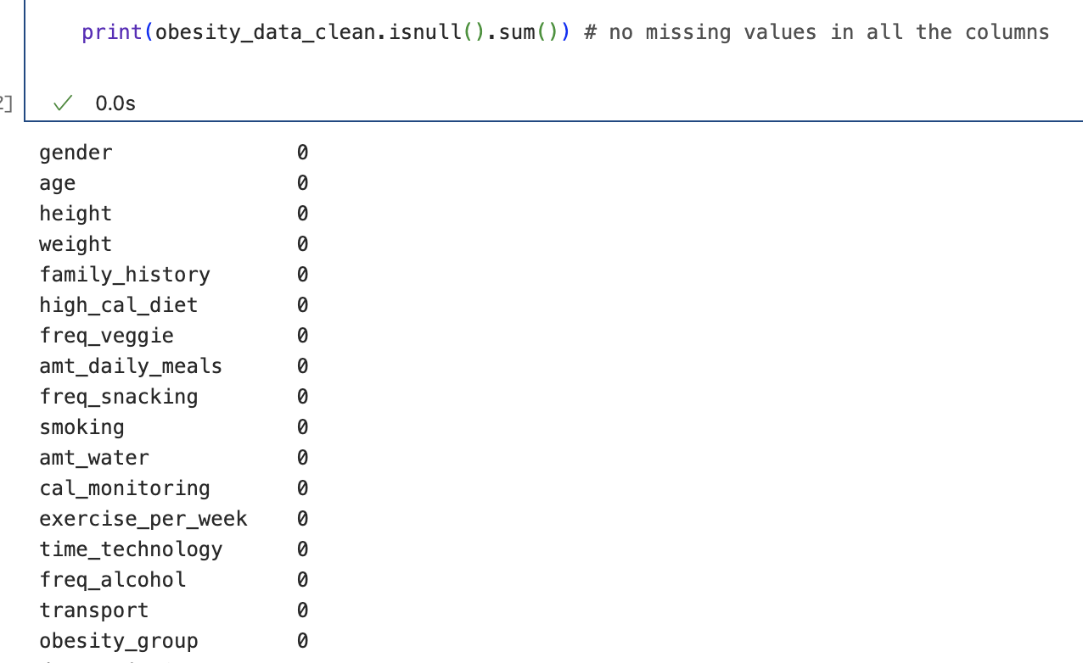
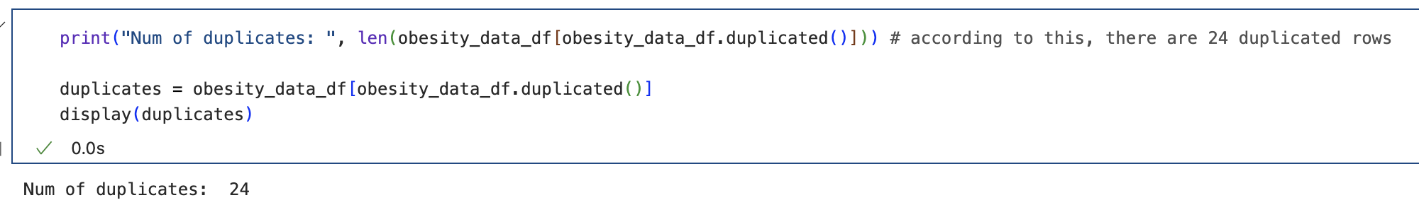
Missing Data, Duplicates
Verified no missing data
24 duplicates (removed)
Notes:
Example on next slide of the amount of water drank

Slide 8
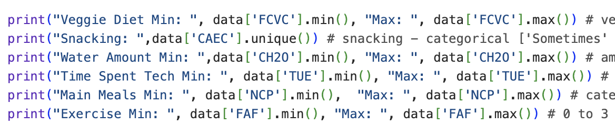
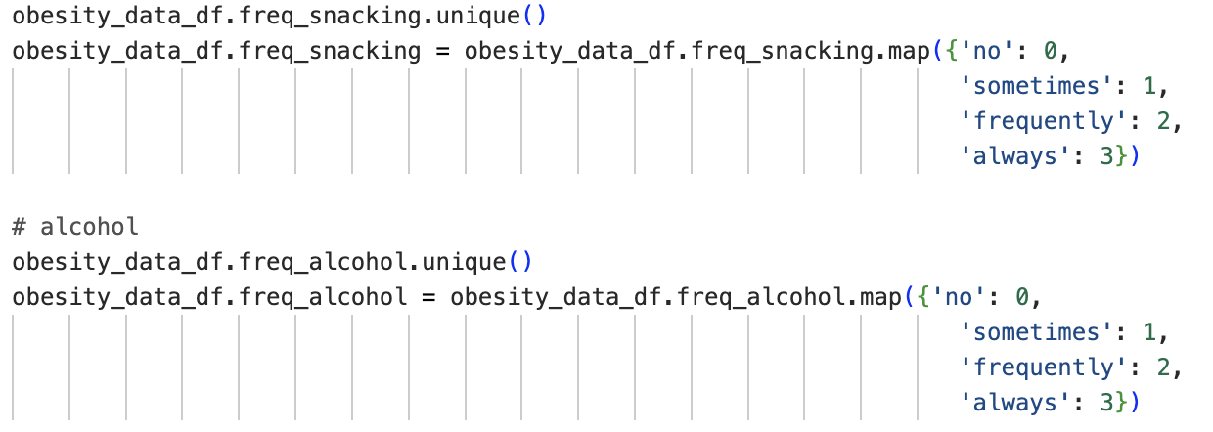
Verifying Data Types and Recoding Variables
Unique (for categorical), max and min (for numeric) variables (code example below):
For binary columns, recoding 0 “no” and 1 “yes”
Changing categorical labels to numeric for later analysis:
No: 0
Sometimes: 1
Frequently: 2
Always: 3
Histograms to confirm data types - some described as categorical in the data dictionary are actually continuous floats (on next slide)

Slide 9
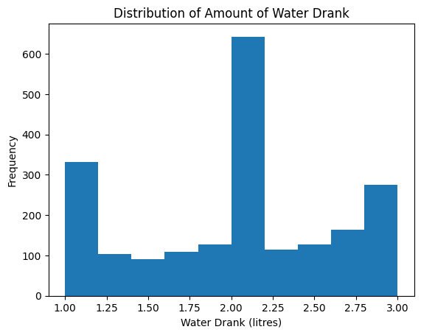
Histogram of Amount of Water Drank
Histogram doesn’t match with data dictionary saying this variable is “integer”:
1: <1 liter per day
2: 1-2 liters
3: 3+ liters
→ suggest verifying with researchers how this was measured
Notes:
Not shown here, but repeated this for a few other variables like number of meals eaten per day where researchers’ description was that these are categorical integers, but this is clearly not what the data shows.

Slide 10
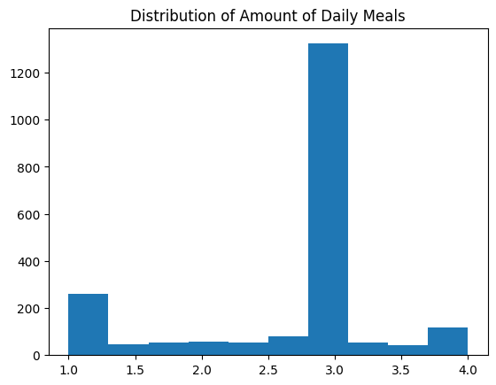
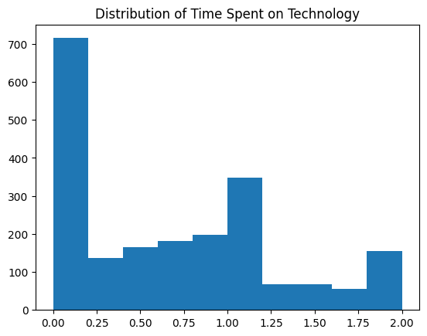
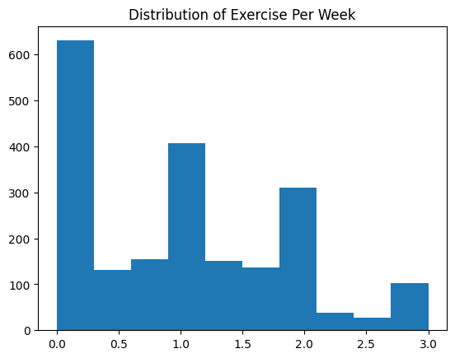
Other variables described as “integer” by researchers
Notes:
I think probably the online survey had these as sliders

Slide 11
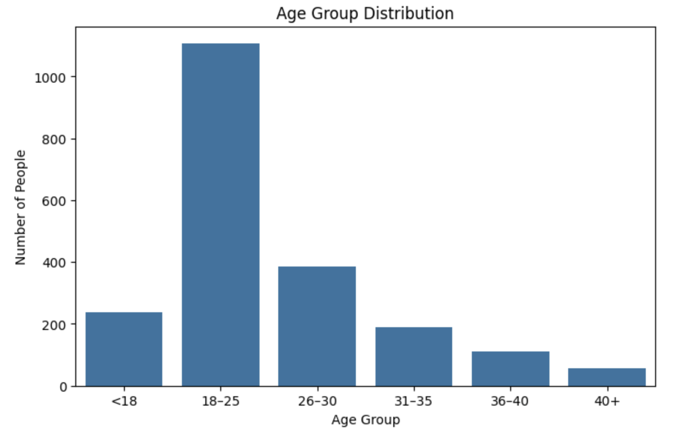
Distribution of Age

Slide 12
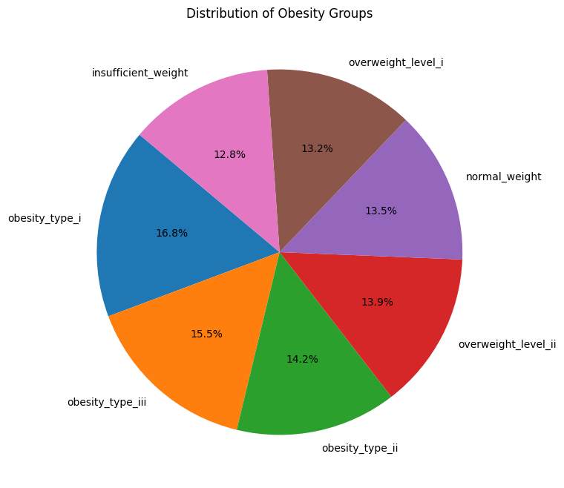
Obesity Groups
6 groups increasing in clinical severity based on BMI - calculated by researchers using height and weight, labelled based on norms for Mexico and WHO
Underweight < 18.5
Normal 18.25 - 24.9
Overweight 25.0 - 29.9
Obesity I 30-34.9
Obesity II 35-39.9
Obesity III > 40
Notes:
Quite balanced across obesity groups - useful because it means that any relationships with other variables are not just related to sample size differences

Slide 13
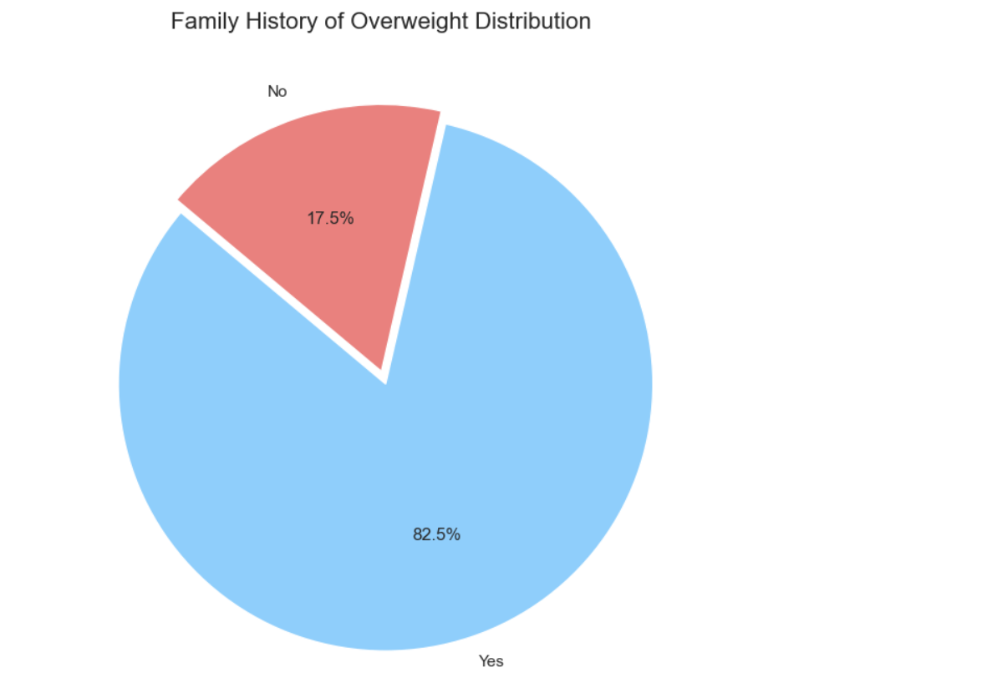
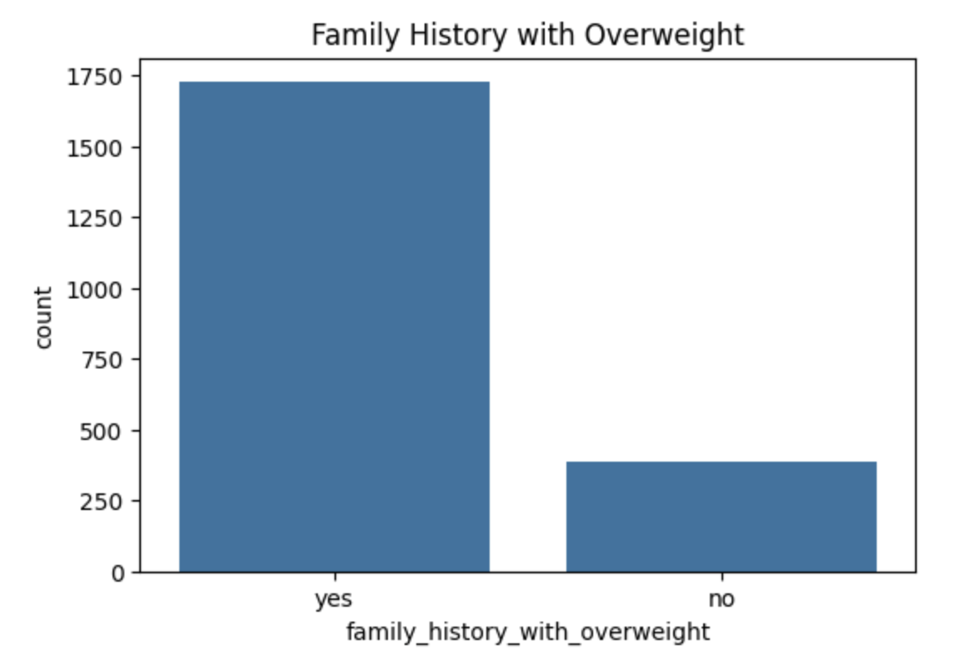
Family History of Overweight

Slide 14
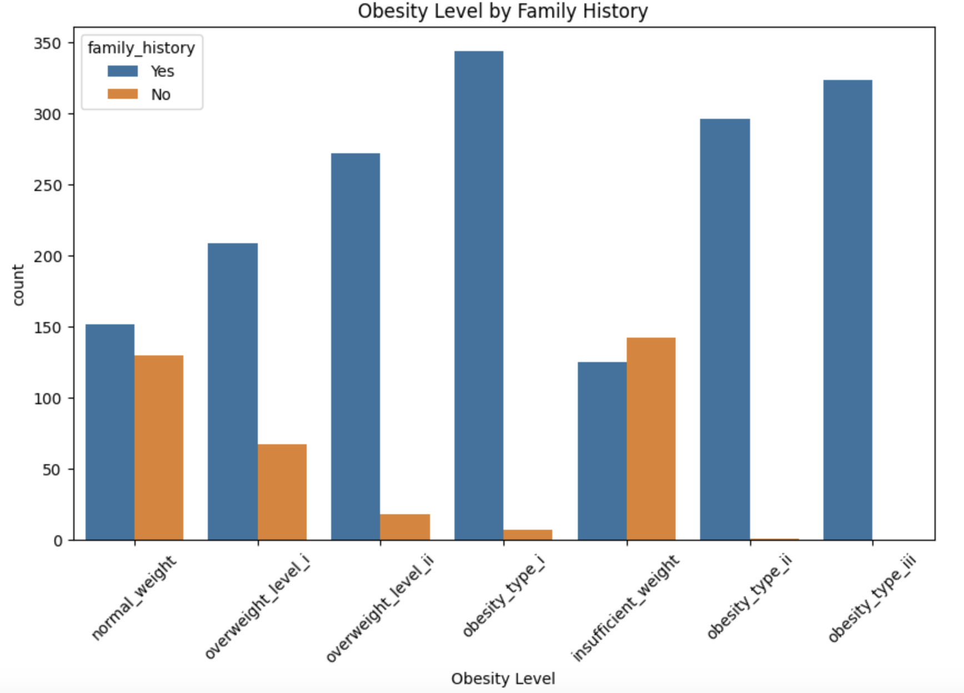
Obesity Level by Family History

Slide 15
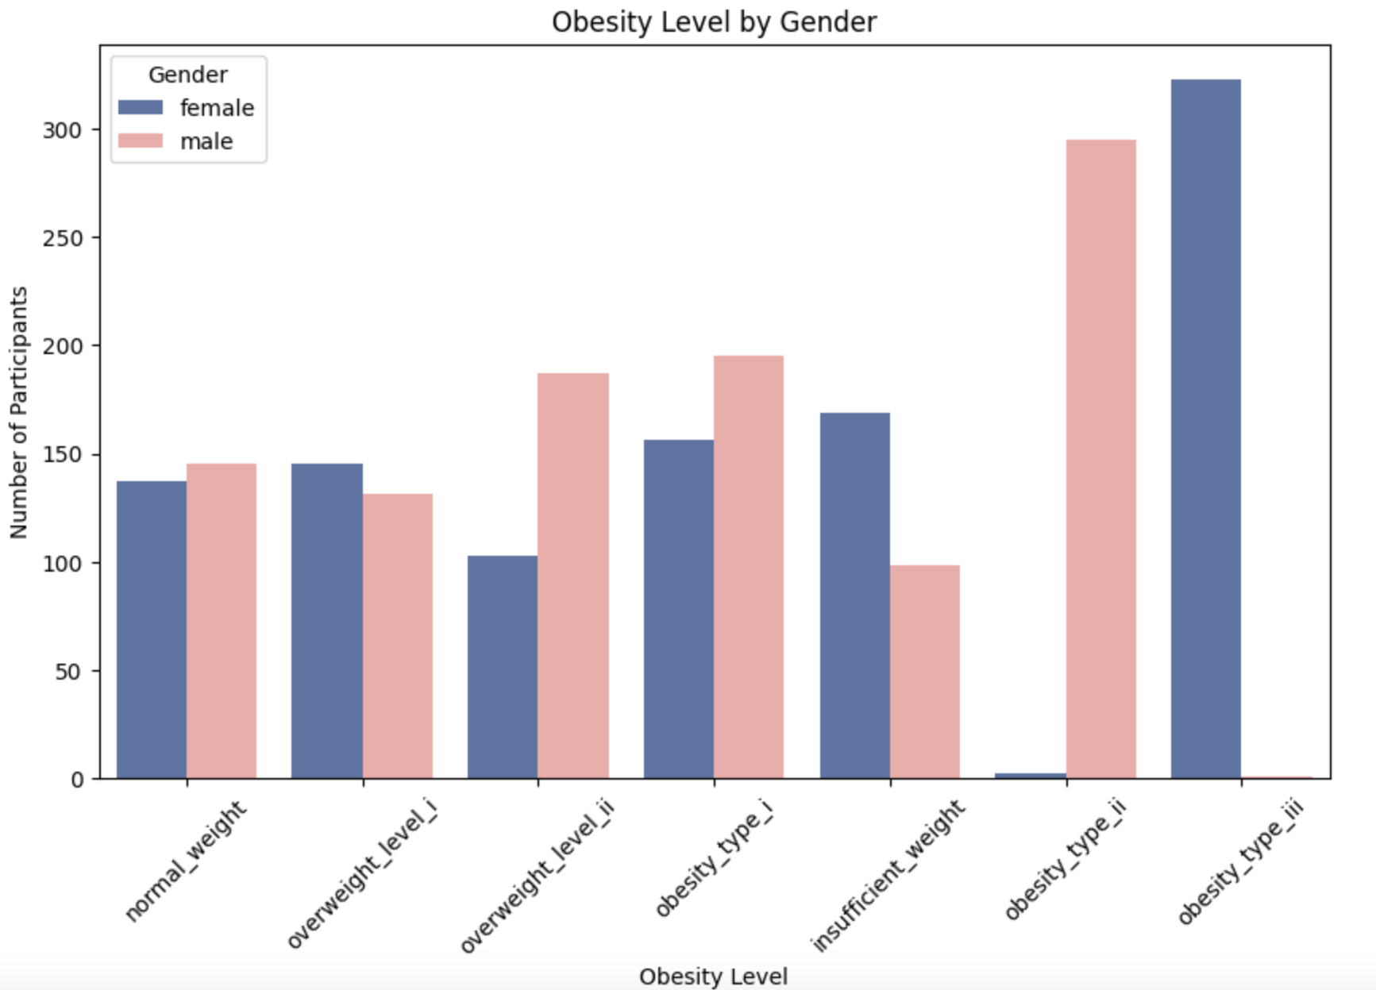
Obesity Level and Gender

Slide 16
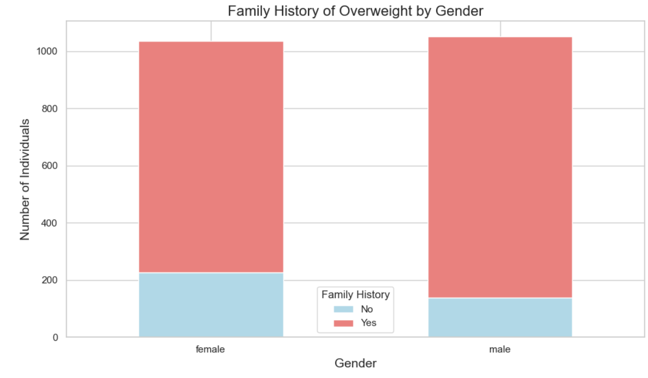
Gender, Family History and Obesity Level
Notes:
This stacked bar chart shows the distribution of family history of overweight among males and females. In both genders, a large majority of individuals reported having a family history of overweight. The number of males and females without a family history is much smaller. Overall, family history appears to be common among both males and females in the dataset, which suggests that genetic or familial factors may play an important role in obesity risk.

Slide 17
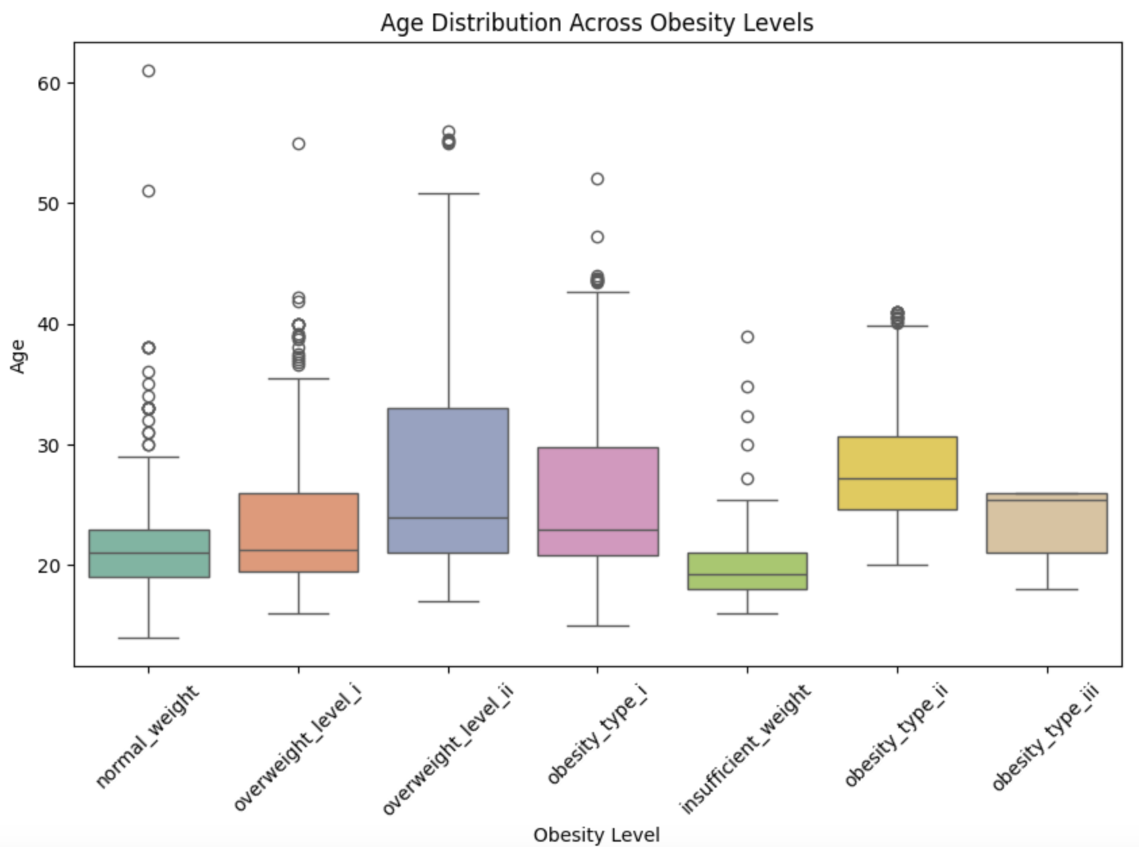
Age vs Obesity Levels

Slide 18
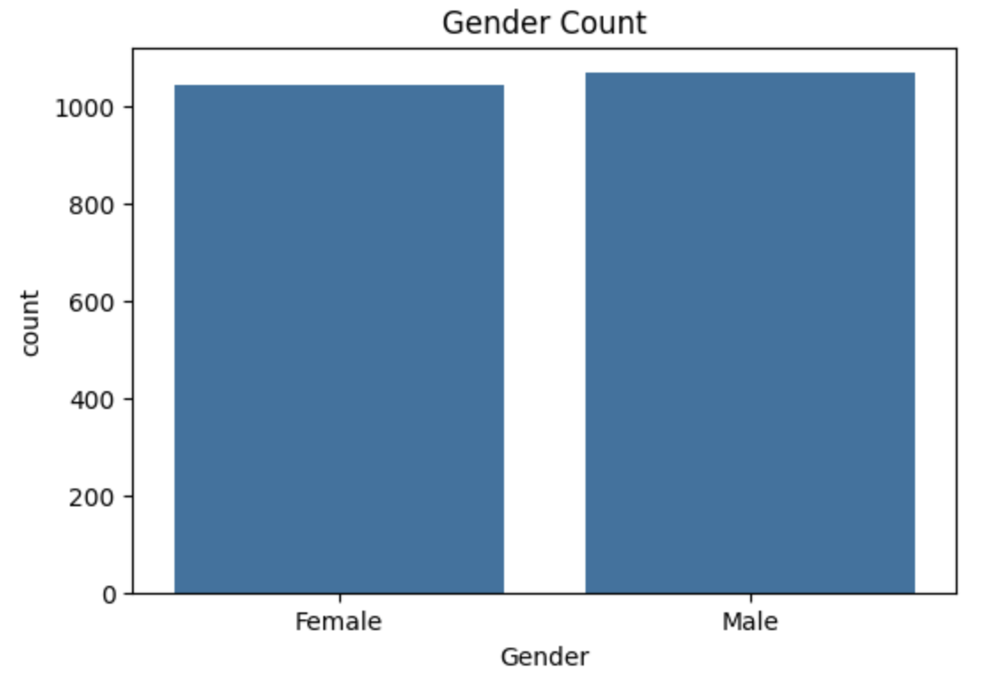
Distribution of Gender
Notes:
The Gender Count graph shows that the dataset is almost perfectly balanced between male and female participants. Both genders have
#approximately the same number of individuals, with a very small difference. This balance ensures that gender-related analyses can be
#conducted without significant bias toward one gender. A balanced dataset like this is ideal for studying the impact of gender on eating
#habits, physical condition, and obesity levels.

Slide 19
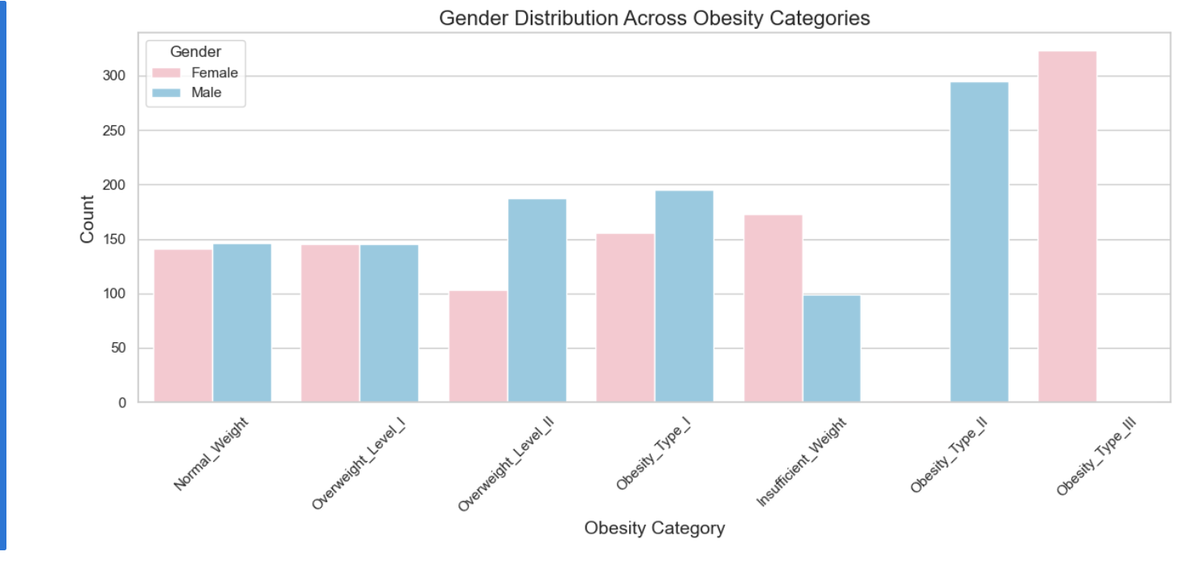
Gender and Obesity Level
Notes:
The bar plot shows the number of males and females in each obesity category. For Normal Weight and Overweight Level I, the number of males and females is almost the same. However, more males are seen in Overweight Level II, Obesity Type I, and Obesity Type II. On the other hand, more females are found in Insufficient Weight and Obesity Type III. This shows that males in the dataset are more likely to be moderately obese, while females are more likely to be underweight or severely obese.

Slide 20
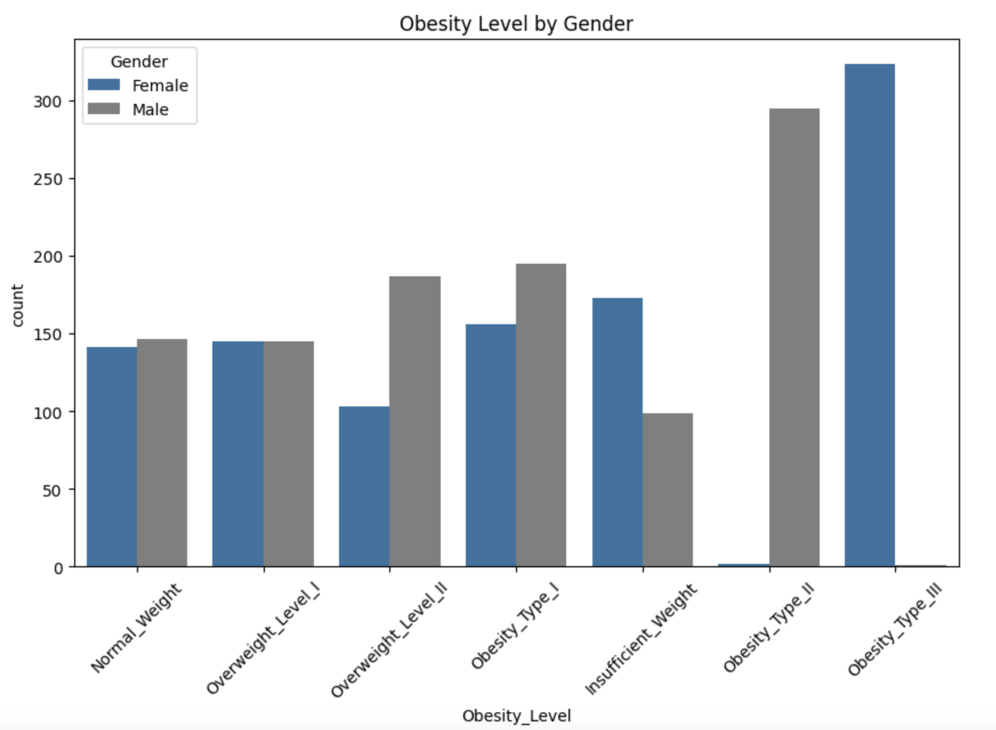
Bivariate Analysis
Gender vs Obesity Level
Notes:
#The bar plot shows the distribution of obesity levels across genders. Overall, males have slightly higher counts in categories such as
#Overweight Level II and Obesity Type I, while females appear slightly more frequent in Obesity Type III. Normal weight and Overweight Level
#I categories have almost equal representation between males and females. Interestingly, more females are categorized as Obesity Type III
#compared to males, suggesting a potential trend towards higher obesity severity among female participants in this dataset. However, the
#differences are not extremely large and further analysis would be needed to confirm strong gender patterns.

Slide 21
Correlation between height and weight
A moderate positive correlation (0.46) was found between Height and Weight. This indicates that, in general, taller individuals tend to weigh more. However, since the correlation is not very strong, it suggests that other factors besides height, such as diet, physical activity and genetics, also play important roles in determining a person’s weight in this dataset.

Slide 22
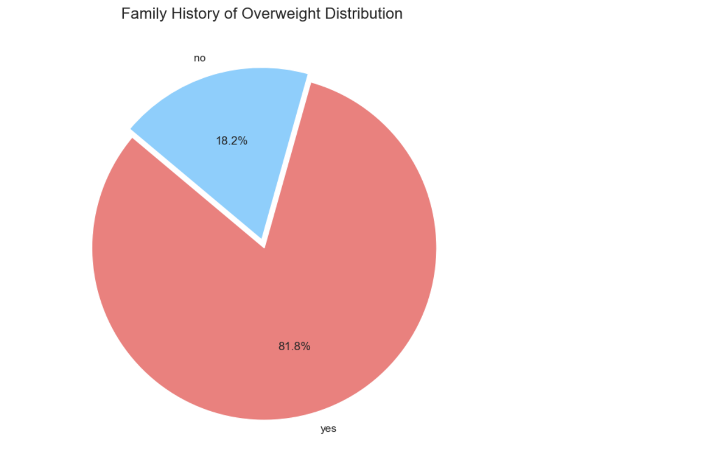

Slide 23
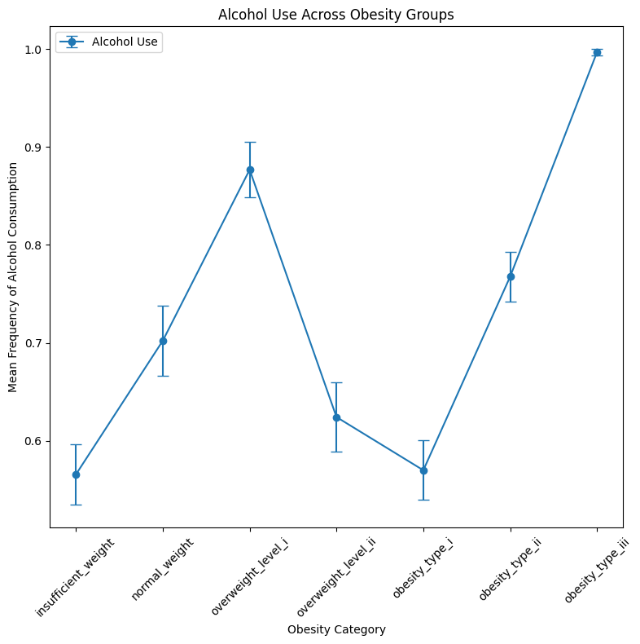
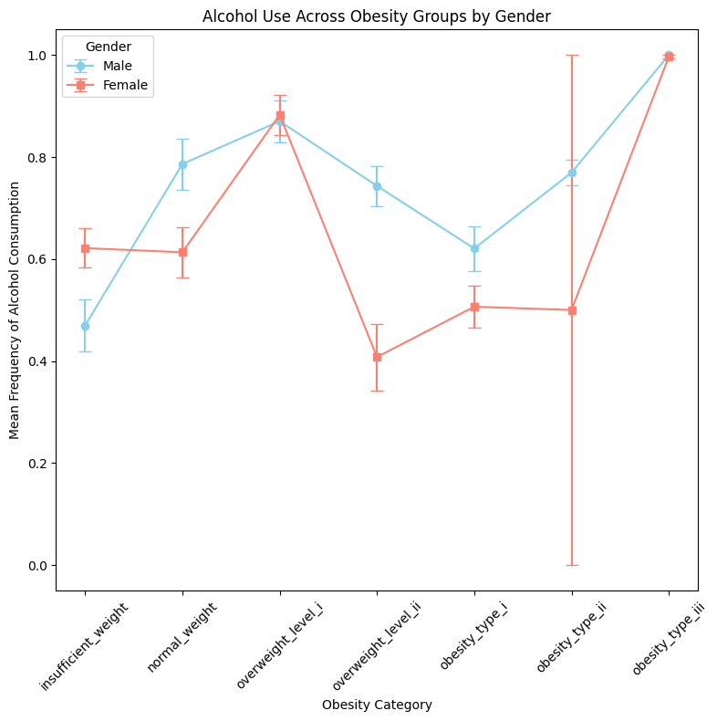
Alcohol and Obesity (and gender differences)
Unclear trend (non-linear)
Gender differences in alcohol consumption across obesity groups
Notes:
0 means never, 1 means sometimes
Unclear trend regarding alcohol consumption frequency, but highest level of alcohol consumption in most severe obesity group
And there are gender differences:
Large error bar for females in obesity type II is probably because there are very few females in that group (large standard error mean)
Generally, females from overweight level II up to obesity type II drink less alcohol than males, but underweight females drink more alcohol than men
Also frequency is different from quantity - which would also be important to measure.

Slide 24
Python Code:

Slide 25
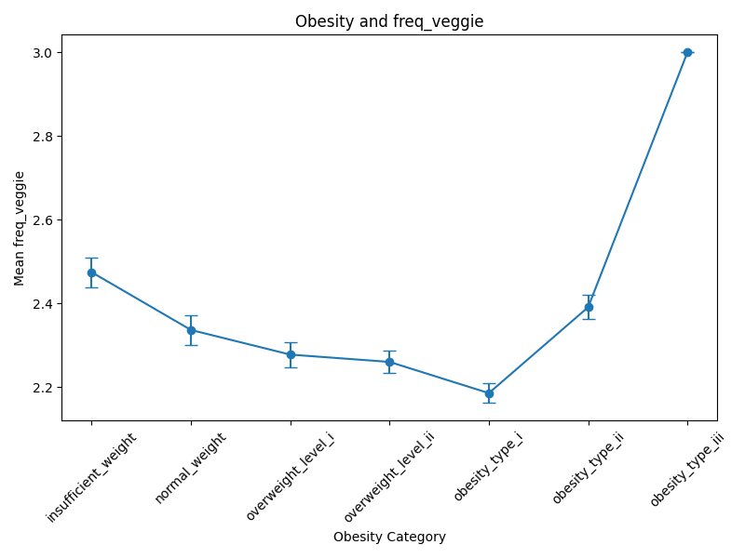
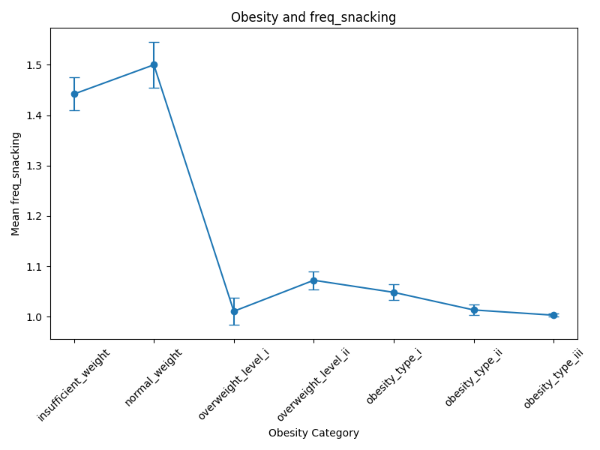
Dietary Factors
Vegetable consumption decreases up until obesity I, then increases for the most severe groups
Snacking decreases with obesity groups.
Notes:
Might seem counter intuitive that people who have more severe obesity are eating more veggies (which are more healthy), but this is likely because those highest risk levels (for doctors and clinical management) probably involve diet plans and nutrition consultants to prevent worsening of conditions.
Implies that an important feature to consider should be whether the participants are involved in, or havae ever been involved in treatments.

Slide 26
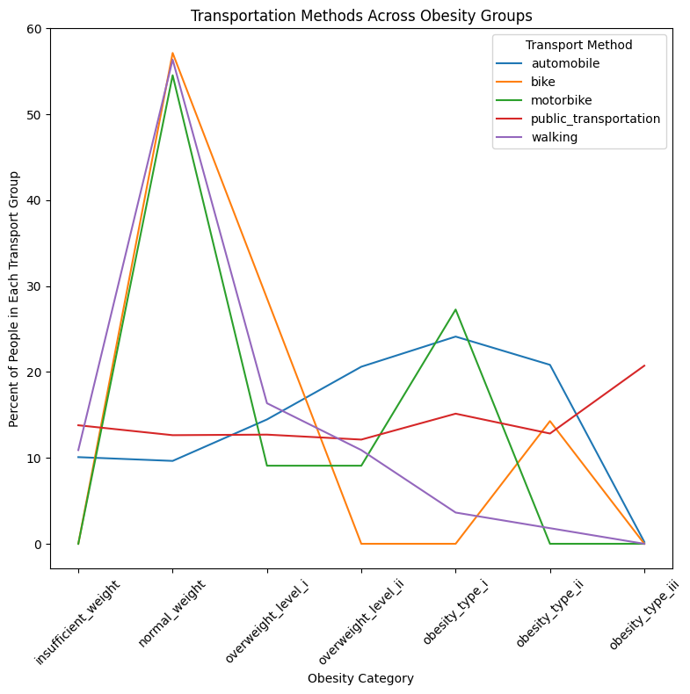
Transport Methods and Obesity Level
> 50% in the normal weight group report, walking, biking and motorbikes as their main method of transport.
Walking decreases as obesity increases in severity
Automobile use increases with obesity severity, except for obesity type II and III
→ But transport and health linked closely to income/socioeconomic status
Notes:
less walking → more overweight/obese
Could also be more overweight → less walking (chronic pain/cardiova
Could be that obesity is so severe that it impairs mobility (even getting to car/driving) / these individuals are not leaving their house much
Differences in transport is likely linked to socioeconomic status (which is not measured here), as is health - important information to collect

Slide 27
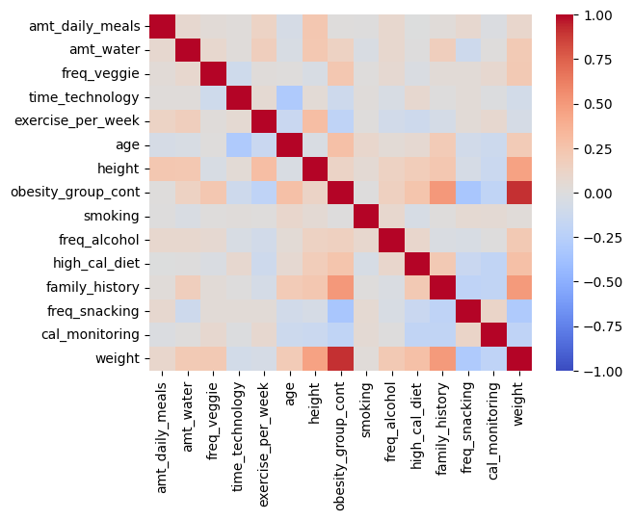
Correlation Heatmap
Represented obesity group as numeric (increasing in severity)
Darkest colour indicates strongest correlation
Features linked to obesity severity:
Family history
weight
But this only captures any linear relationships
Notes:
Limitation is that heatmap can only capture linear relationships, which we can see is not really the case for alcohol, and some other variables too.
Included only variables that are continuous (or can be treated as continuous) - technically binary groups are not continuous (they are 0 and 1)

Slide 28
Code:
# FILTERING TO INCLUDE ONLY APPROPRIATE NUMERIC VARIABLES
continuous_variables_filter = ['amt_daily_meals','amt_water','freq_veggie','time_technology','exercise_per_week','age','height','obesity_group_cont','smoking','freq_alcohol','high_cal_diet','family_history','freq_snacking','cal_monitoring','weight']
continuous_variables = obesity_data_clean[continuous_variables_filter]
continuous_variables.head()
# CORRELATION MATRIX
corr_mat = continuous_variables.corr()
# SEABORN HEATMAP
sns.heatmap(corr_mat, cmap = “coolwarm”, vmin = -1, vmax = 1)

Slide 29
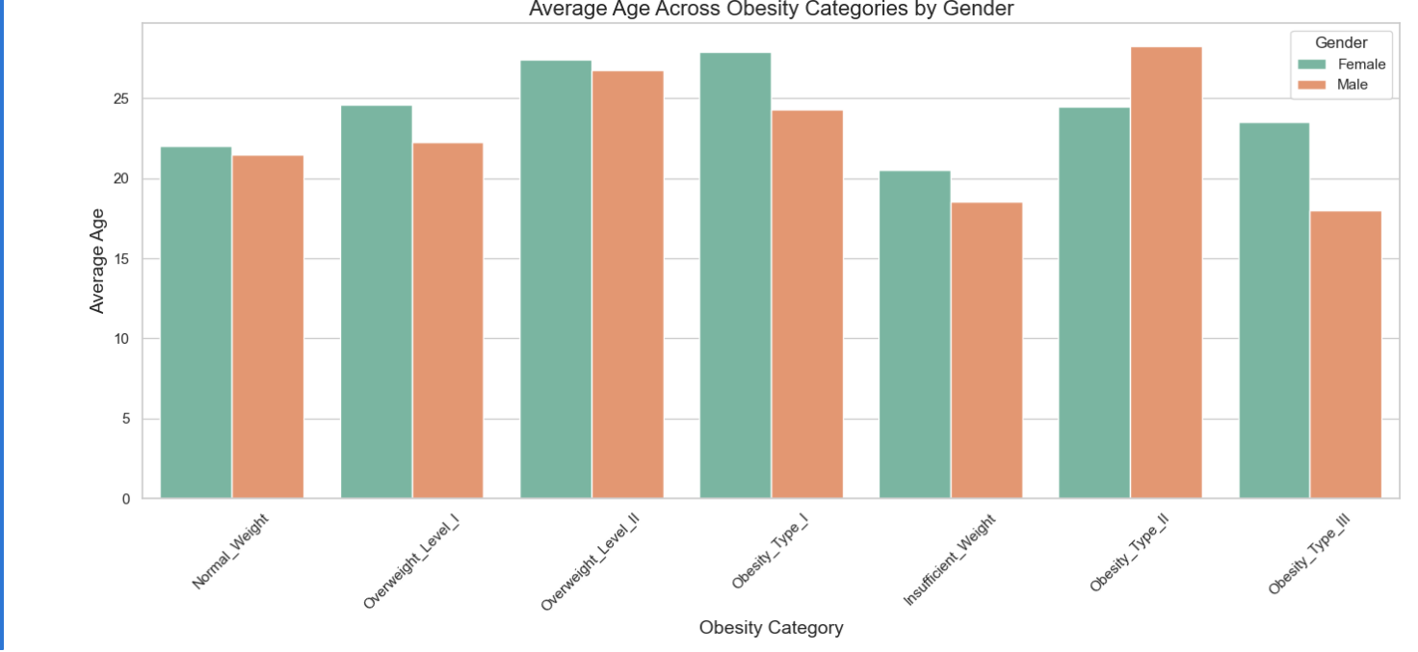
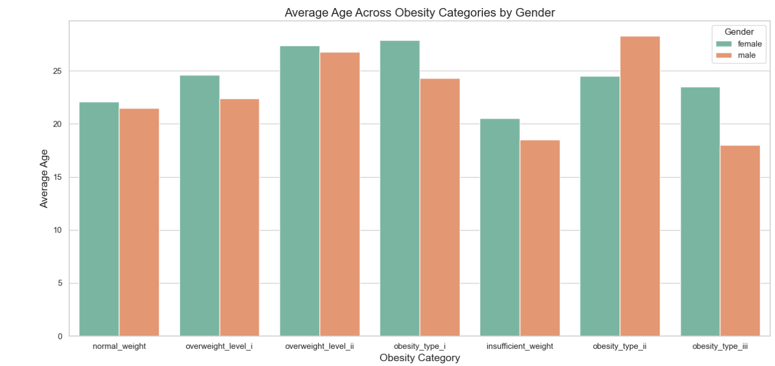
Age vs Obesity Level, Split by Gender
Notes:
This bar plot shows the average age of individuals across different obesity categories, separated by gender. In most categories, females have a higher average age compared to males. Individuals with normal weight are mainly young adults, with no major gender difference. In moderate overweight and obesity levels (Overweight Level I, II, and Obesity Type I), females tend to be slightly older than males. However, in severe cases such as Insufficient Weight and Obesity Type III, males are younger than females. These patterns suggest that age and obesity are related differently for males and females in this dataset, with severe obesity occurring at younger ages for males and moderate obesity more common at older ages for females.

Slide 30
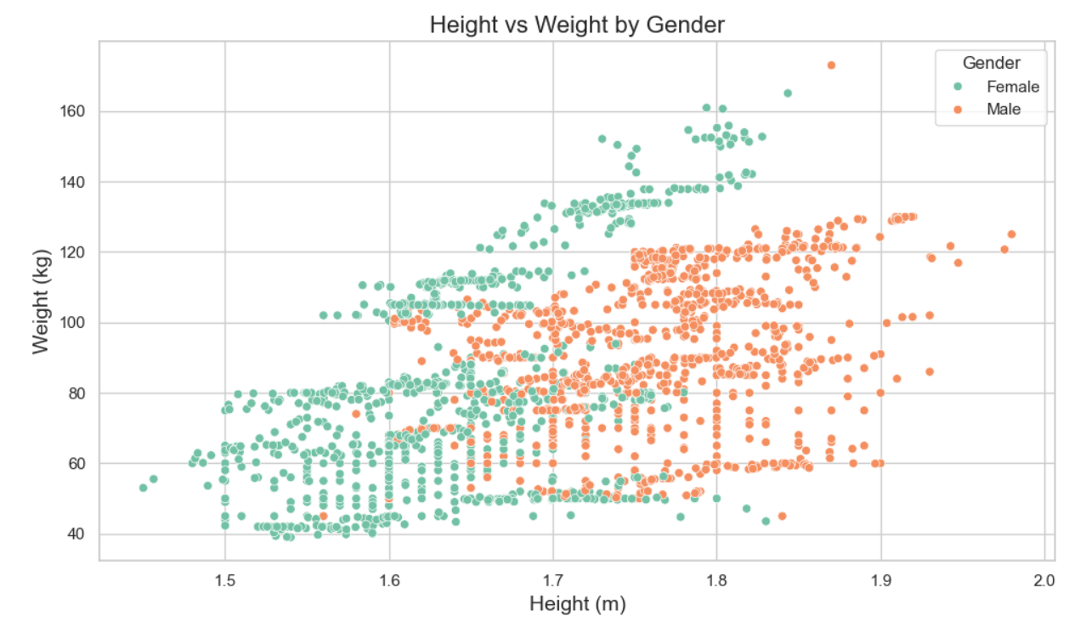
Relationship between Height and Weight, by Gender
Female rho: 0.48
Male rho:
0.37
Notes:
This scatter plot shows the relationship between height and weight, colored by gender. There is a clear positive relationship, where taller individuals tend to weigh more. Males are generally taller and heavier than females, with most male individuals between 1.7 and 1.9 meters in height, and females between 1.5 and 1.7 meters. While there is some overlap in height and weight ranges, males dominate the taller and heavier ends of the distribution. A few outliers exist, representing individuals with extremely high weights. Overall, this plot highlights clear physical differences between genders in the dataset.

Slide 31
Summary
This exploratory data analysis provided meaningful insights into the factors influencing obesity based on eating habits, physical condition, and personal background. The dataset was predominantly composed of young adults with an almost balanced gender distribution, allowing for unbiased gender comparisons.
Key patterns emerged from the analysis: individuals with a family history of overweight were significantly more likely to fall into higher obesity categories, highlighting the strong influence of genetic and familial factors.
Gender differences were modest but visible, with slight variations in obesity severity between males and females.
Age was also an important dimension, as participants classified into more severe obesity types tended to be slightly older, suggesting that obesity risk may accumulate with age even within a relatively young sample.
The correlation analysis confirmed a moderate positive relationship between height and weight, as expected, but also pointed toward the importance of lifestyle factors beyond physical attributes alone.
→ Alcohol use is clearly important, but need to be considered alongside gender (not a linear relationship)
→ Transportation use is also an important feature to consider, but is also linked to economic status, which was not measured.
Overall, the analysis emphasizes that while biological factors such as genetics and body structure matter, lifestyle habits also play an important role, but the relationships may not be linear. These findings support the idea that tackling obesity requires a holistic approach, addressing both inherited tendencies and modifiable behaviors.
Notes:
Family history

Slide 32
Limitations
Although the dataset provides useful insights, there are several limitations. Most participants were young adults, limiting generalization
to older populations.
Some features, such as eating habits and physical activity, are self-reported, which can introduce reporting bias.
Also need to verify with researchers how certain variables were measured as histograms don’t match with reported data type.
Analysis was limited to available variables; other important factors such as socioeconomic status, medical conditions/treatments, or psychological conditions were not included.
→ Future studies with a more diverse population and broader feature set would provide a more complete understanding of obesity risk factors.

